Slide 1
TITLE PAGE
Problem Statement ID – 20471373
Problem Statement Title- AI-Based Smart Energy Management System for Buildings
Theme- Smart Automation / Clean & Green Technology
PS Category- Software
Student Name: Athreya Shashidhara
Student ID: PES1UG23CS120

Slide 2
AI-Driven Digital Twin for Real-Time Building Energy Optimization
Proposed Solution (Describe your Idea/Solution/Prototype)
A closed-loop AI system pairs an EnergyPlus/OpenStudio digital twin of a building with an on-prem LLM (Qwen3-8B) that reads live sensor data (indoor/outdoor temp, occupancy, HVAC load, weather) and outputs validated HVAC/lighting setpoint actions, which are executed and re-simulated to confirm real savings
Replaces static, rule-based Building Management Systems with a system that continuously reasons over live building state to cut energy waste while keeping occupants comfortable
Combines physics-based simulation with generative-AI reasoning, plus a strict validator and feedback loop that measures ACTUAL post-action energy, carbon and comfort gains — not just predictions

Slide 3
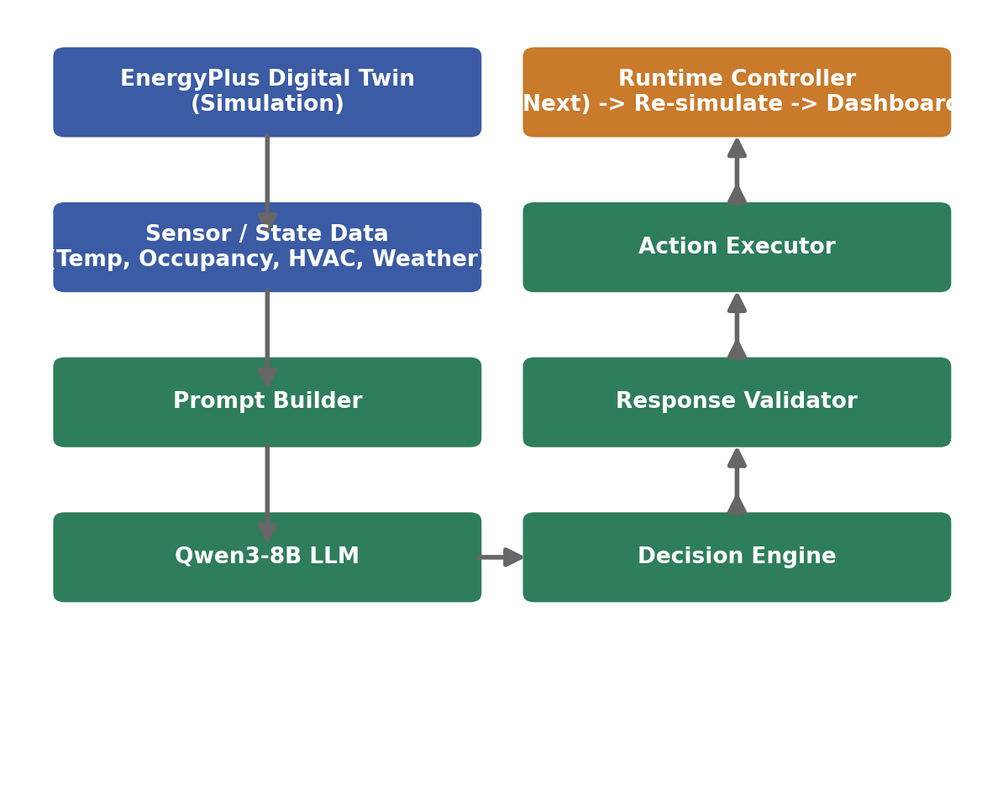
TECHNICAL APPROACH
Technologies used:
EnergyPlus + OpenStudio (.osm) – physics-based digital twin of the building
Qwen3-8B LLM with GPU inference for on-prem reasoning
Python services: Model Loader, Prompt Builder, Inference Engine, Decision Engine, Response Validator, Action Executor, Runtime Controller
Structured JSON action schema + Metrics Engine dashboard
Methodology:
Live sensor data is converted to a structured prompt, sent to the LLM, and returned as a validated JSON recommendation that is executed and re-simulated to confirm real energy, carbon and comfort gains (see pipeline)

Slide 4
FEASIBILITY AND VIABILITY
Core AI pipeline (Model Loader, Prompt Builder, Qwen3-8B Inference, Decision Engine, Response Validator, Action Executor) is already built and working; EnergyPlus/OpenStudio are mature, widely-used simulation tools with open Python APIs, making end-to-end integration realistic
Key risks: GPU inference latency for near real-time control, LLM outputs drifting outside safe HVAC operating limits, and syncing live sensor feeds from heterogeneous Building Management Systems
Strategies: Response Validator enforces hard confidence/setpoint limits before any action executes; the upcoming Runtime Controller will link the Decision Engine directly to EnergyPlus/OpenStudio APIs

Slide 5
ARTIFACTS
Modules completed so far:
Model Loader – loads Qwen3-8B + tokenizer with GPU inference support
Prompt Builder – converts sensor values (temp, occupancy, price) into a structured LLM prompt
Decision Engine – parses the LLM’s JSON output into Strategy / Confidence / Actions / Predictions objects
Response Validator – checks confidence range, setpoint limits and required fields before execution
Action Executor – converts validated actions into executable HVAC/lighting commands (e.g. Cooling Setpoint -> 25°C)

Slide 6
RESEARCH AND REFERENCES
EnergyPlus Simulation Engine – energyplus.net
OpenStudio SDK – openstudio.net
Qwen3 Model Family – Alibaba Cloud Qwen Team, open-weight LLM release
Literature on LLM-assisted building energy management and reinforcement-learning-based HVAC control

